Slide 1
Hospital Management System
Requirement Analysis & Feasibility Study Presented by : Group 5
Student ID:1005011
1005016
1005019
1005021
1005024

Slide 2
Outline of the presentation
Subsystems
Data Flow Diagram
Fishbone Diagram
Feasibility Study
Operational Feasibility
Cultural Feasibility
Technical Feasibility
Economic Feasibility
Cost Benefit Analysis
Tangible and Intangible Benefits

Slide 3
Subsystems
Registration Subsystem
Patient Management Subsystem
Employee Management Subsystem
Billing Subsystem
Scheduling Subsystem

Slide 4
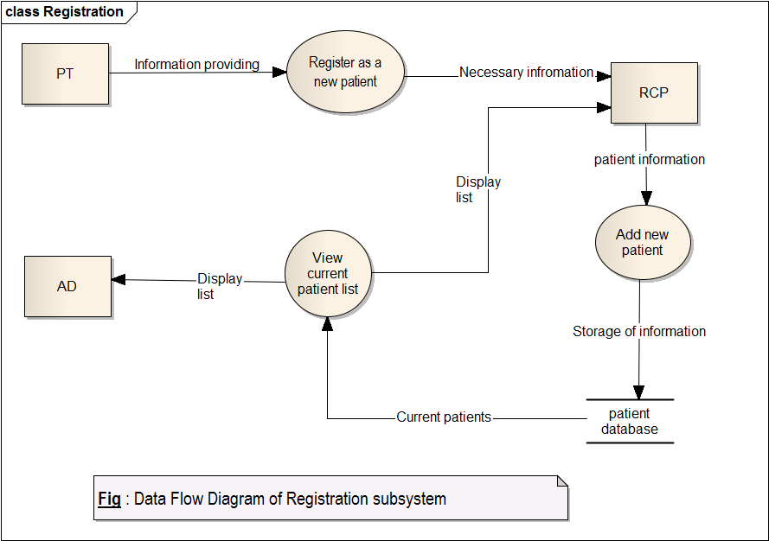
Data Flow Diagrams

Slide 5
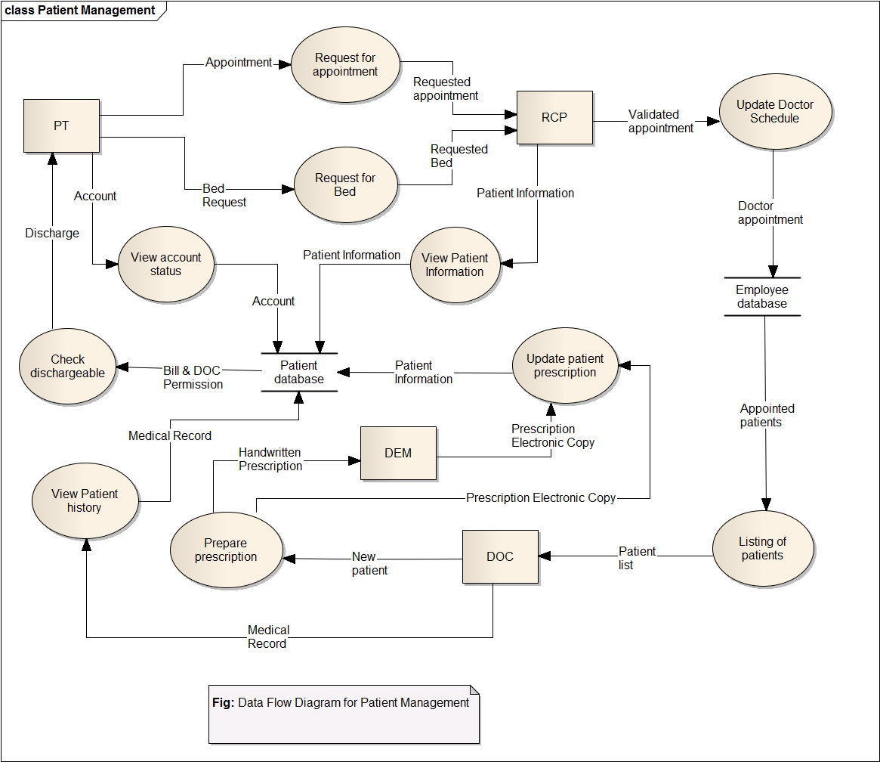

Slide 6
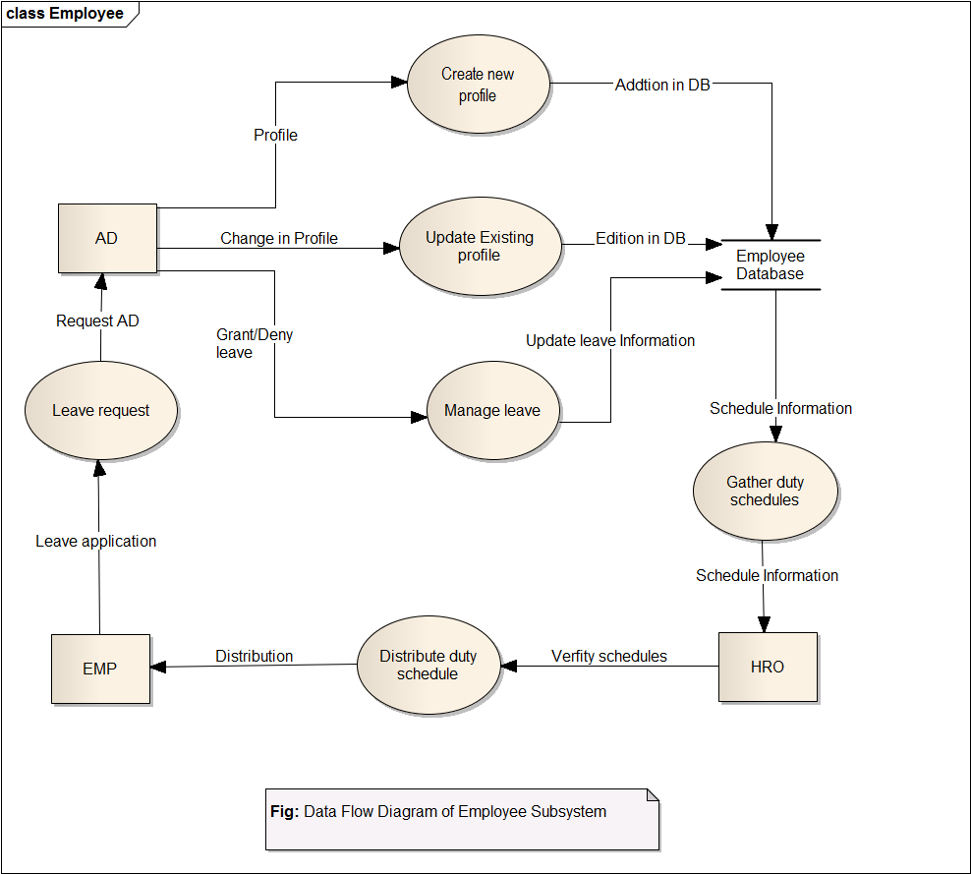

Slide 7
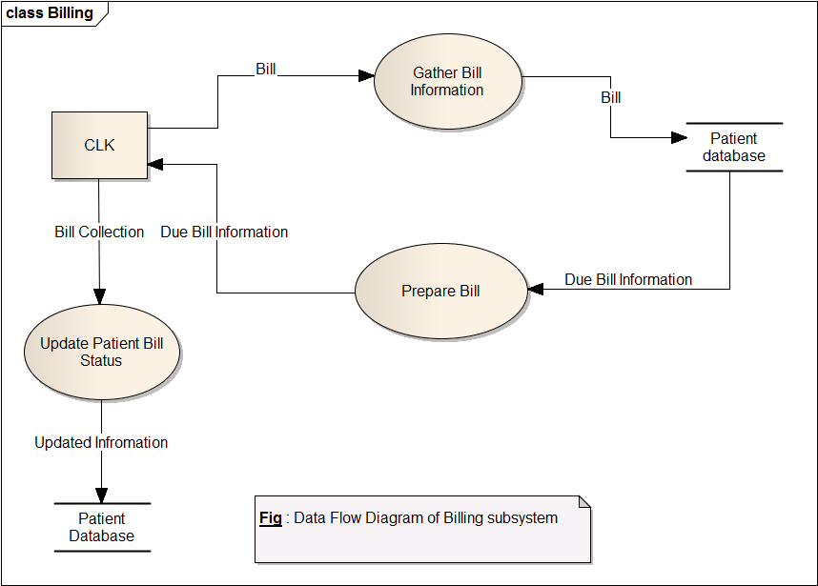

Slide 8
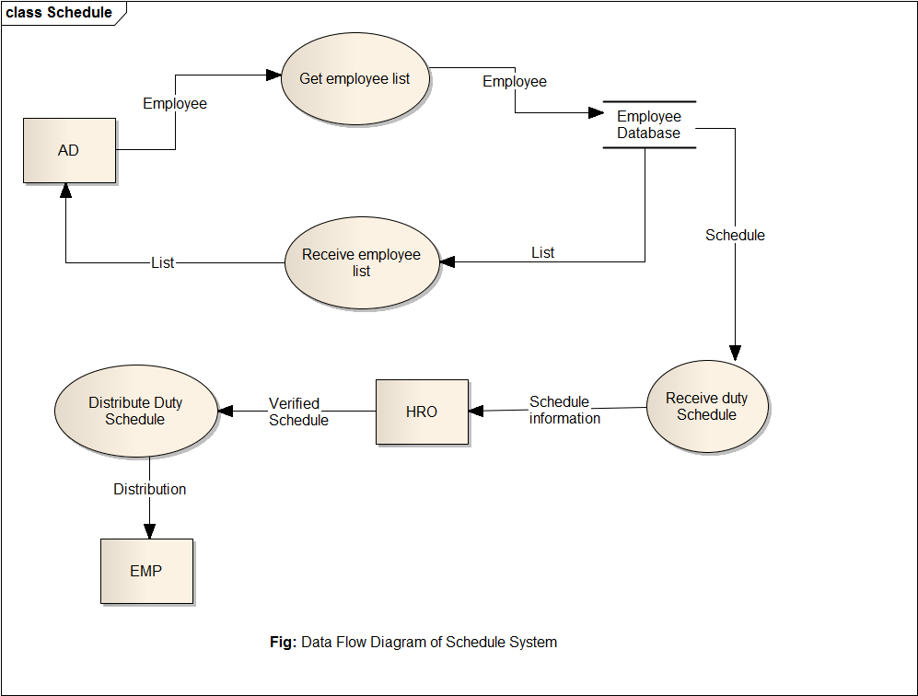

Slide 9
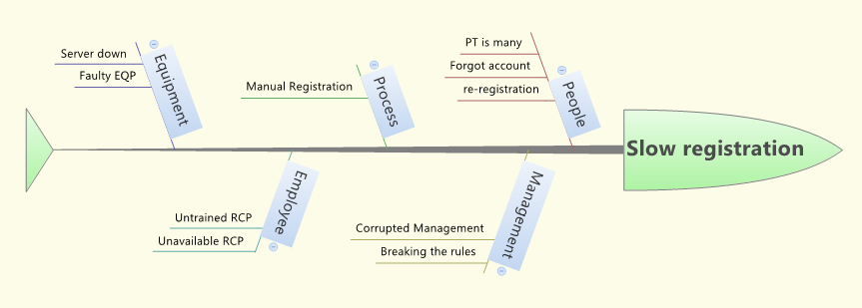
Fishbone Diagram of Registration Subsystem

Slide 10
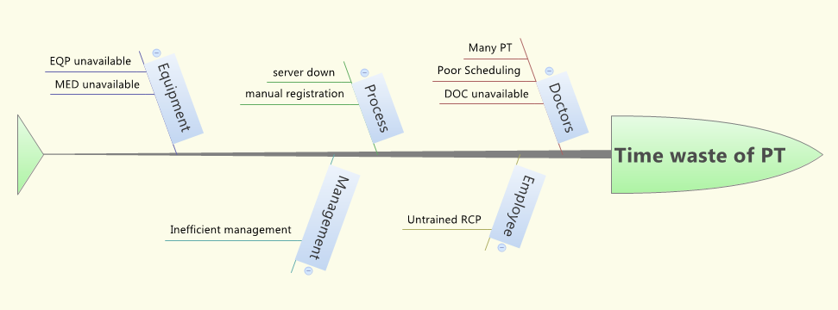
Fishbone Diagram of Patient Management System

Slide 11
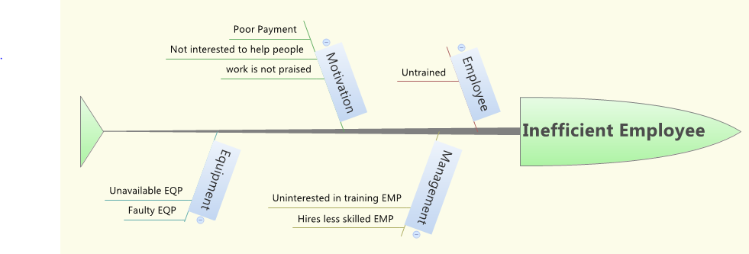
Fishbone Diagram of Employee Management Subsystem

Slide 12
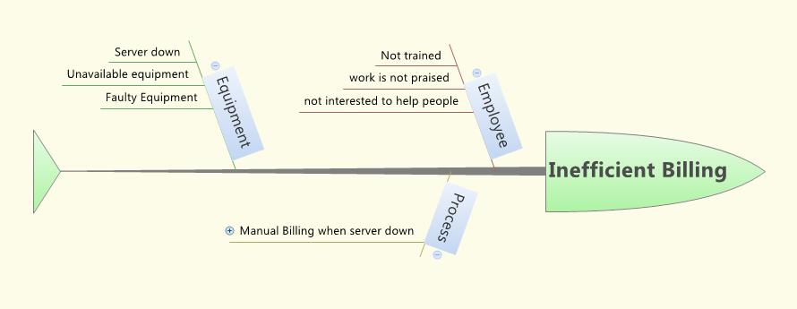
Fishbone Diagram of Billing Subsystem

Slide 13
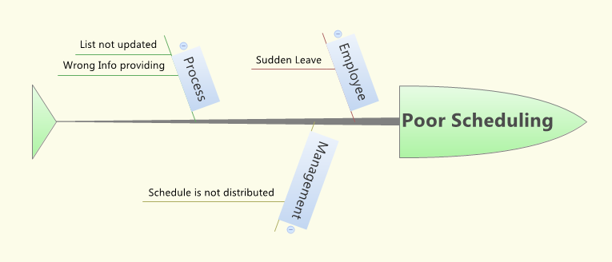
Fishbone Diagram of Scheduling Subsystem

Slide 14
Operational Feasibility:
What changes will be brought with the system?
What new skills will be required?
Do the existing staff members have these skills?
If they don’t have, can they be trained in due time?

Slide 15
Operational Feasibility:
Needs basic information about Windows platform
How to use and manipulate files on system.
Staffs will be well trained within 2-5 days.
Any technical problems occurred will be notified to technical person or software analysts.

Slide 16
Technical Feasibility:
Can project be implemented with the current existing software technology & available?
Can the system be upgraded if developed once?
If new technology is needed then whether it can be developed?
Will specified equipment and software satisfy user requirements?

Slide 17
Technical Feasibility
We will use PHP for server side scripting
Oracle Database for database
Java for software
HTML and CSS for web design
JavaScript for client interface

Slide 18
Economic Feasibility:
Is the project possible, given resource constraints?
Are the benefits that will be acquired from the new system worth the costs?
What are the savings that will result from the system including tangible and intangible ones?
What are the development and operational costs?

Slide 19
Cost Benefit Analysis
Software Development Cost
Expenses for training
New Hardware and Software
Annual Cost

Slide 20
Software Development Cost
Number | Type of Employee | Estimated work time & pay rate | Cost
2 | System Architect & Analysts | 50hours(400tk/hr) | 40000tk
2 | GUI Designer and Programmer | 100hours(350tk/hr) | 70000tk
1 | Database Specialist &System Librarian | 50hours(300tk/hr) | 15000tk
5 | Total |  | 1,25,000 tk

Slide 21
Expenses for training
Number | Type of Trainee | Duration | package | Cost
20 | Doctor | 3 hours | 2000tk | 40000
10 | Clerk | 4 hours | 1500tk | 15000
15 | Receiptionist | 5 hours | 2000tk | 30000
3 | Data Entry Manager | 8 hours | 4000tk | 12000
48 |  | Total |  | 97,000 tk

Slide 22
New Hardware and Software
Number | Type | Per unit cost | Cost
1 | Development Server | 5000tk | 5000tk
1 | Server Software & hosting | 10000tk | 10000tk
1 | DBMS server | 4000tk | 4000tk
2 | DBMS client hosting | 6000tk | 12000tk
35 | Desktop Computer | 25000tk | 8,75,000tk
3 | Printer | 15000tk | 45000tk
 | Wires and Other equipments | 7000tk | 7000tk
 | Total |  | 10,00,000 tk

Slide 23
Annual Cost
Number | Designation | Cost
2 | System Administrator | 2,40,000tk
1 | Database programmer | 1,80,000tk
1 | IT specialist(part time) | 1,00,000tk
1 | Maintenance Agreement server | 5000tk
1 | Maintenance Agreement DBMS server | 10000tk
6 | Total | 5,35,000tk

Slide 24
Subscription Cost
Subscription cost will be 1,00,000tk per year.
With this much money the hospital will be able to use this system and have after sales service and maintenance every year.

Slide 25
Tangible Benefits
Saves 1,50,000tk per year due to having less employee.
Saves money due to purchase of less paper.
Reduces patient hassle.
Reduces 70% administrative work.
Increases employee performance.

Slide 26
Intangible Benefits
Saves patients time
Work is made easier and accurate
Better care from doctor.
Good wishes of patients and their families

Slide 27

QUESTIONS???

